Slide 1

Break The Cycle Campaign Study & Analysis

Slide 2
Campaign Name: Break The Cycle Target Audience: Female 15-35 Category: FMCG (Shampoo) Platform: Facebook Duration: 1st August to 1st November

Slide 3

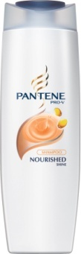
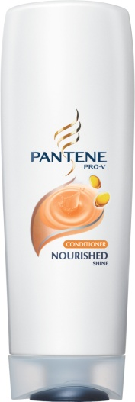
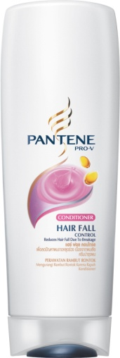
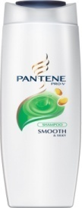
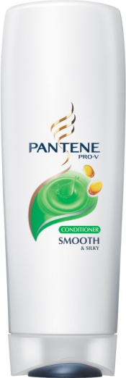
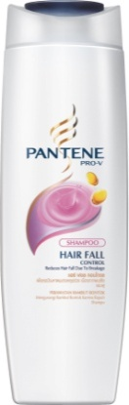
Campaign Objective
To launch three new variants of Pantene Pro V and to induce preference and demand for the same amongst the target audience

Slide 4
The Challenge It was important that the game application was FUN and not sales oriented. As part of the game the women had to realise the ROOT CAUSE of their hair problems and think of Pantene as the BEST suited SOLUTION

Slide 5
Creative Insight
F/ 15 - 35
Hair fall problems
CONSUMER
CONTEXT
Break the Cycle
of Hair fall
CONTENT
A game that gives you a solution

Slide 6
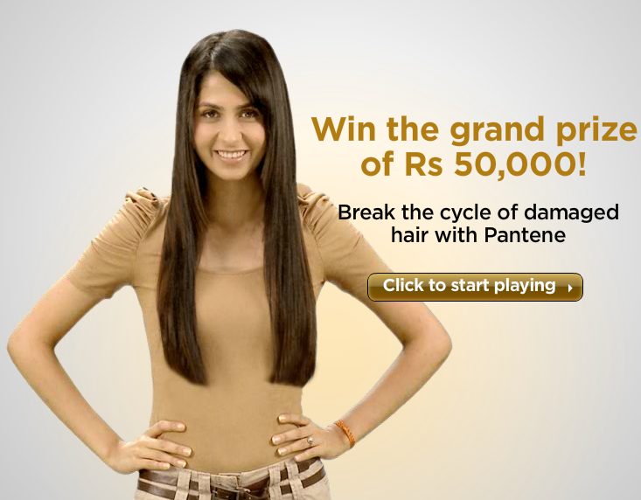
Solution
Break the Cycle of Hair Fall
Facebook Game
by
Pantene

Slide 7
Campaign Concept- Break The Cycle
The campaign was divided into 3 parts
Every part had a situational level on the game which a consumer on Facebook has to go through
The situational level is made up in a way which a consumer can relate to as her own daily life
Every time she passes these situations in a situation in that level her hair get damaged and look unhealthy
By selecting and using the correct shampoo the girl can move to the next levels and finish the game to Win 50,000!

Slide 8
Use correct Shampoo Smooth & Silky
Move to level 2
Level 2 Hairfall Problem
Use correct Shampoo HairFall Control
Level 1 Dry & Frizzy Hair
Move to Level 3
Level 3 Split Ends
Use Correct Shampoo Nourished Shine
Start Here
Game Flow

Slide 9
Campaign Performance
More than 58% of the audience were non customers from the Target Audience between the age of 18-35 years
The interactions on the Page increased by 92% from 12140 to 23409
Organic growth of around 40,000 Fans on the Page via the campaign

Slide 10
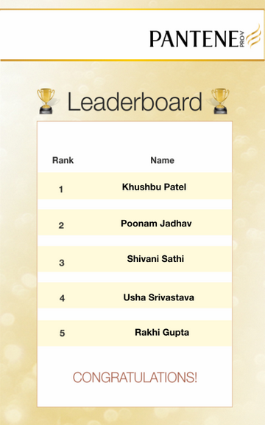
Leader board
We maintained a Leaderboard with Daily top 5 girls in the league towards winning the Grand Prize of
Rs 50,000

Slide 11
Level 1
Heat, sun & dust can damage your hair, by making it look Dull & Dry
By using Pantene’s Smooth & Silky Shampoo, your hair can look shiny and healthy
Level 1- Desert scene
Correct Variant Smooth & Silky

Slide 12
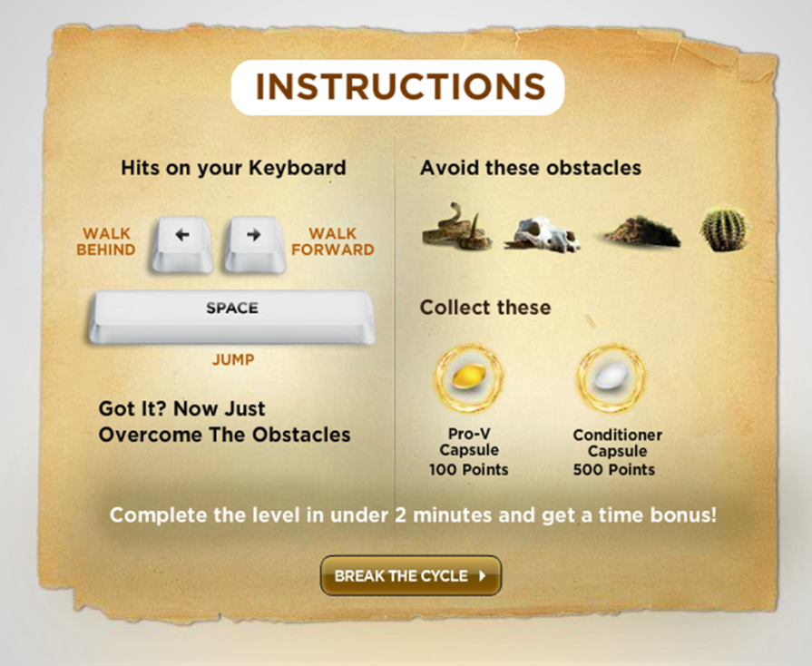
Instructions page

Slide 13
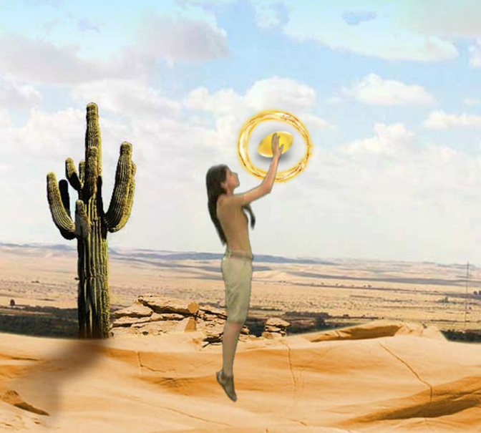
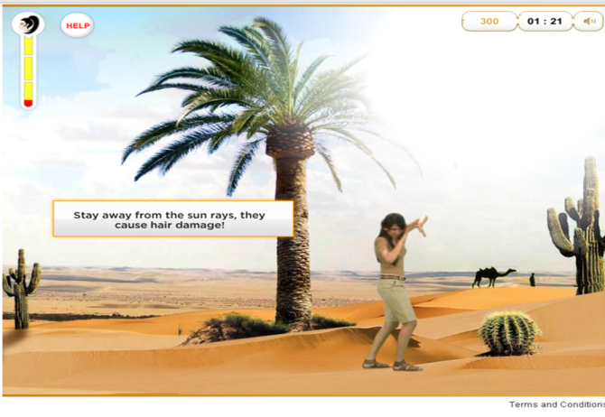
Collect Pro-V capsules and avoid the obstacles in order to increase points
Avoid the strong sun rays in order to protect your hair
At one point, the sun rays starts beaming down on her and one portion will becomes really bright.
Here, she bends and shades her eyes in order to avoid the glares

Slide 14
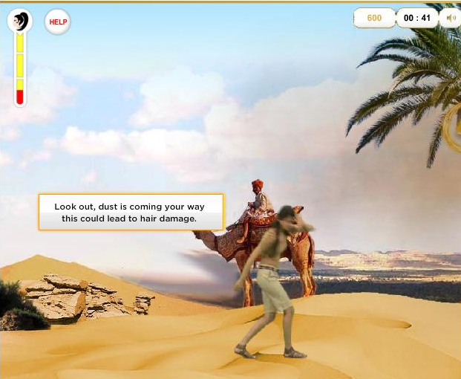
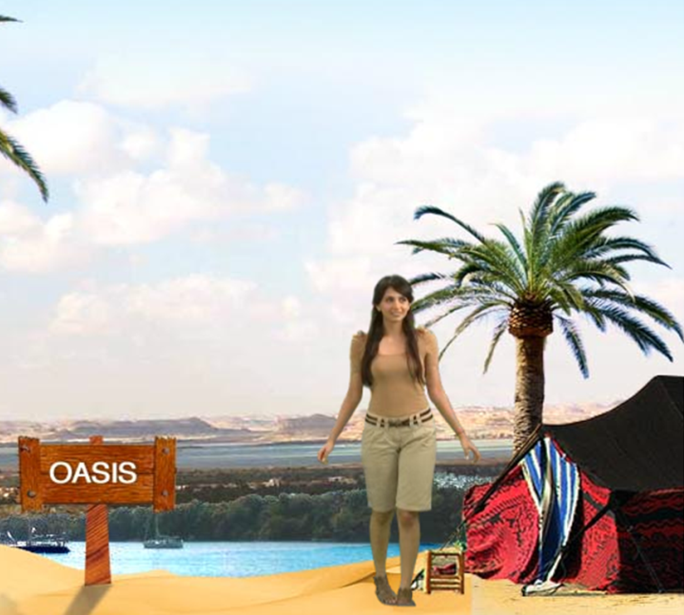
Hair Health-o-Meter
We created a Hair Health-o-Meter to display the level of healthy hair she is left with
At the end of level 1, she reaches the oasis.
When she reaches, a dialog box pops up detailing the causes of dryness and frizz and asks her to choose between the three Pantene Shampoos

Slide 15
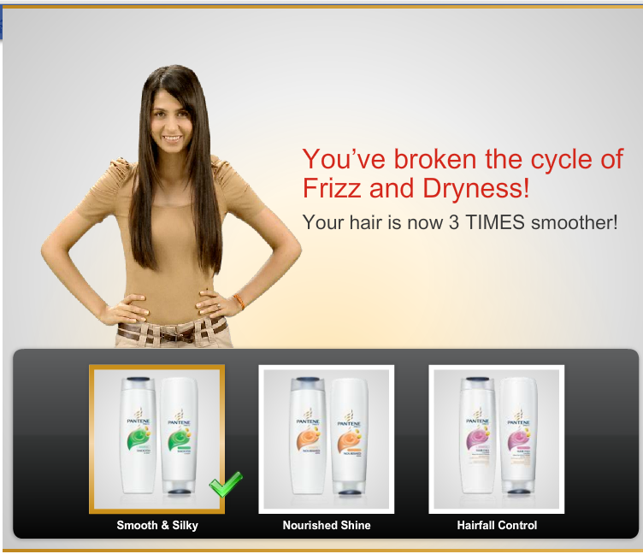
The correct Shampoo for this Level was – Smooth & Silky
After Playing level 1 her hair became Dry & Frizzy, so in order to make her hair Healthy, she had to select the correct Shampoo!

Slide 16
Level 2
This level focuses on the stress one goes through in an office. One of the sole reasons for Hairfal is Stress. Hence the correct shampoo to be used is Hair Fall control
Level 2- Office scene
Correct Variant Hair Fall Control

Slide 17
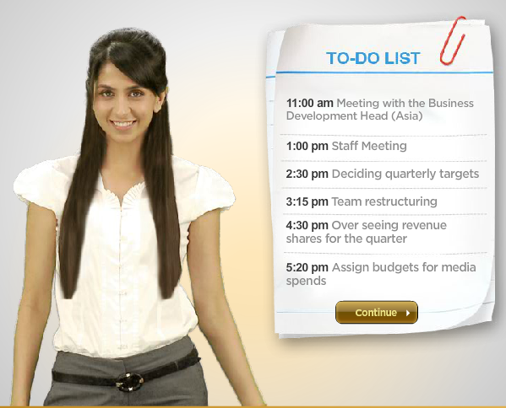
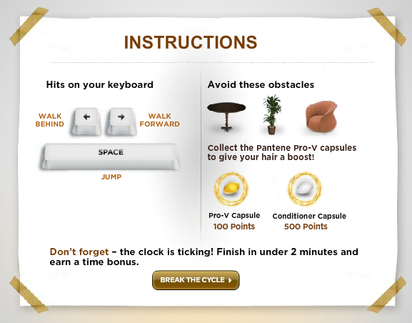
Instructions page

Slide 18
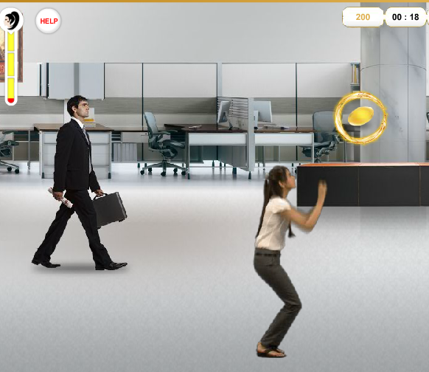
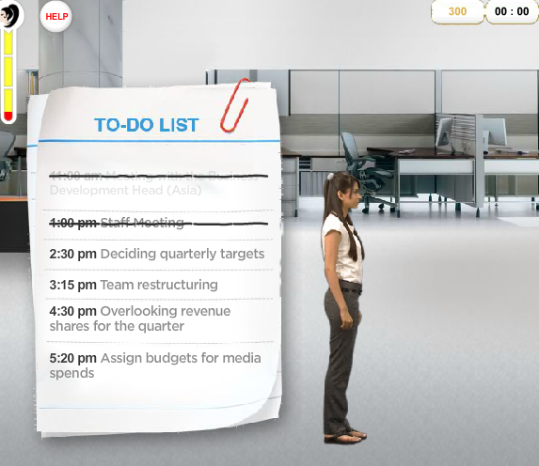
She had to collect the Pro-V capsules in order to
finish her to-do’s & increase points
As she completes her tasks, the things on her To-Do list get striked off

Slide 19
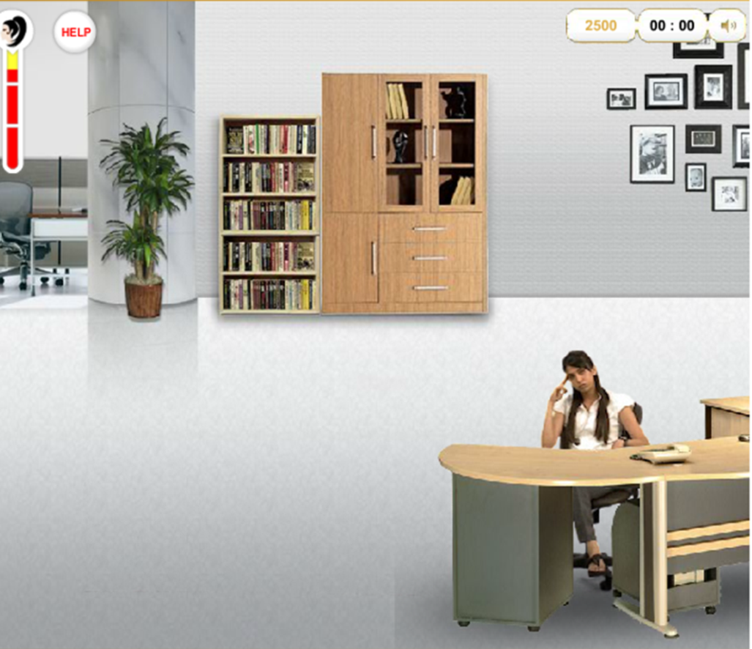
End of Level 2
Tired and stressed after a long day’s work…phew!

Slide 20
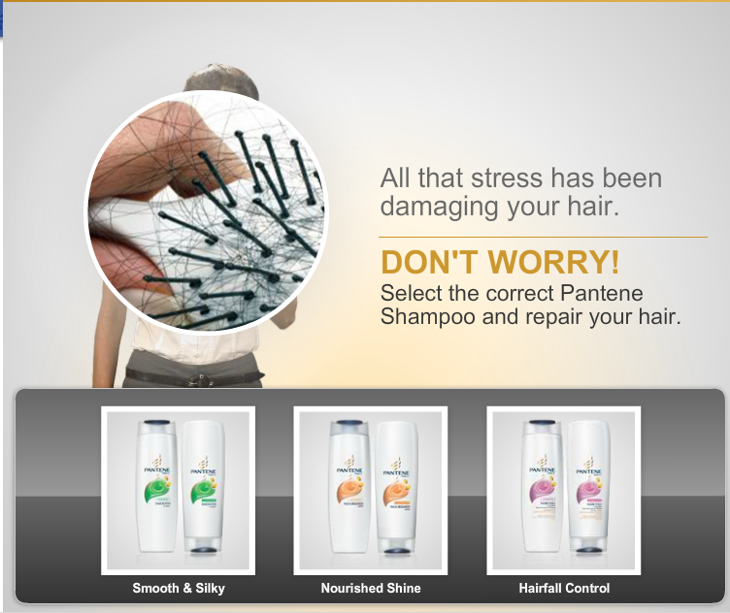
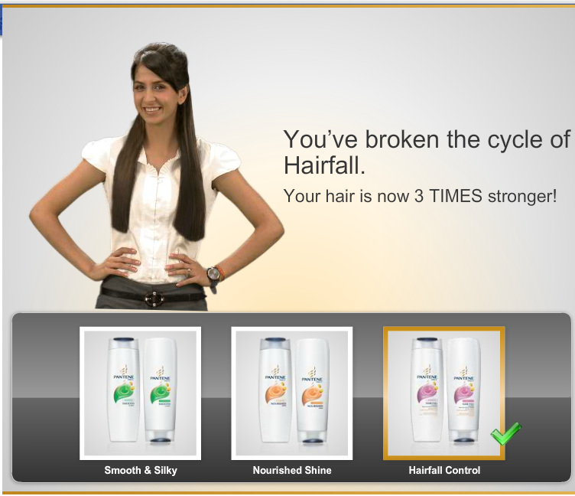
The correct Shampoo for this Level was – Hair Fall Control
After Playing level 2 her hair fall increased due to all the stress at work. In order to make her hair Healthy, she had to select the correct Shampoo!

Slide 21
Level 3
Use of Hair straighteners can damage our hair with Split ends
In this level, the girl had to get ready for a Party in the evening, for which she straightened her hair, which in return damaged her hair.
This level helped the users understand the correct variant that needs to be used
Level 3- Party scene
Correct Variant Nourished Shine

Slide 22
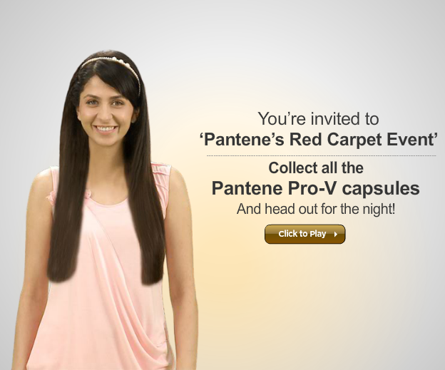
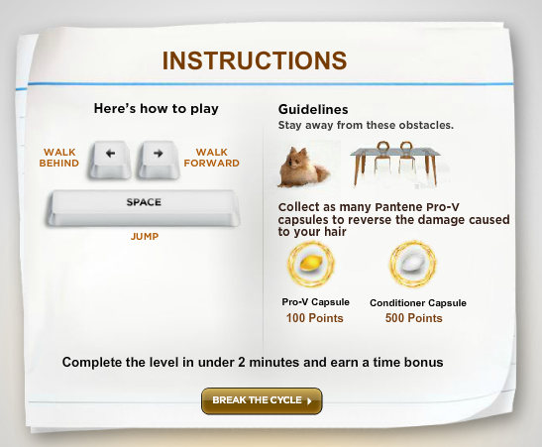
Instructions page

Slide 23
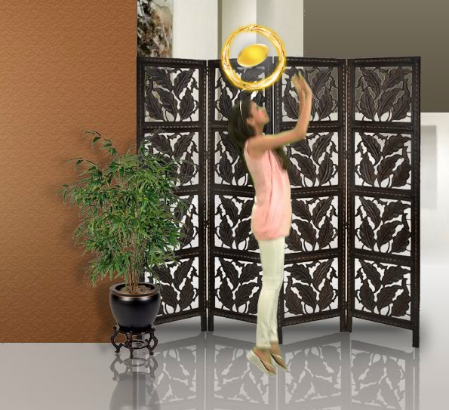
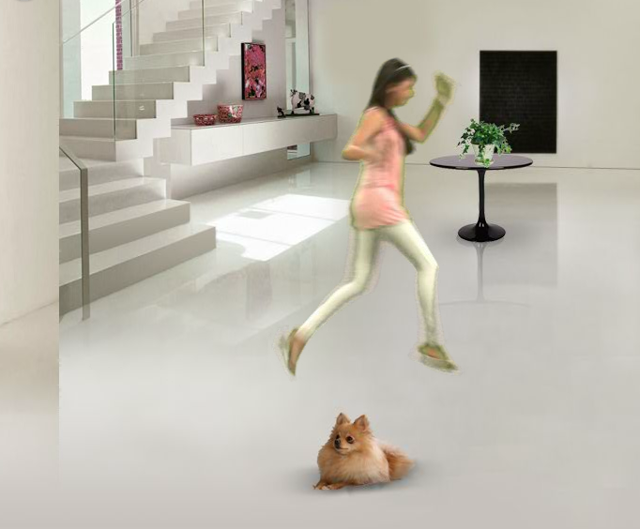
Collect Pro-V capsules and avoid obstacles in order to increase points
Avoid the obstacles

Slide 24
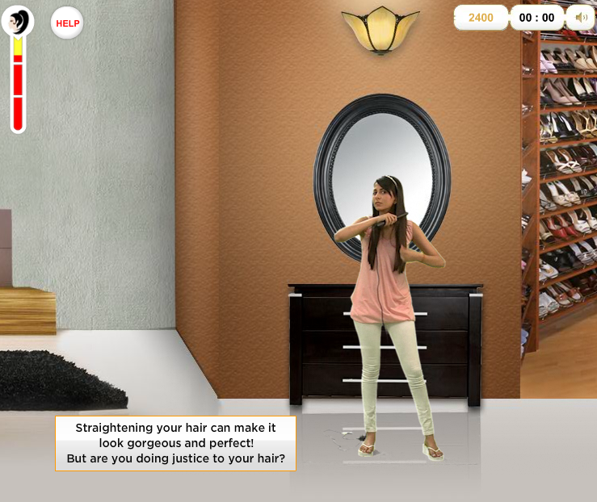
Time to get ready for the Party!
Ooops! But the straightening has damaged her hair!

Slide 25
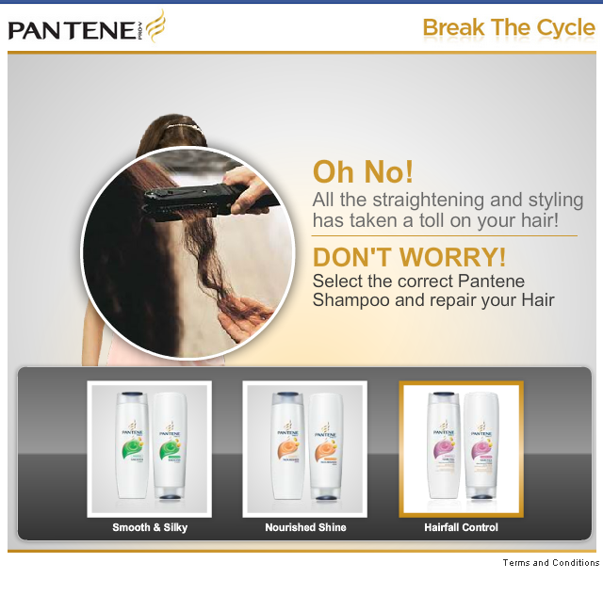
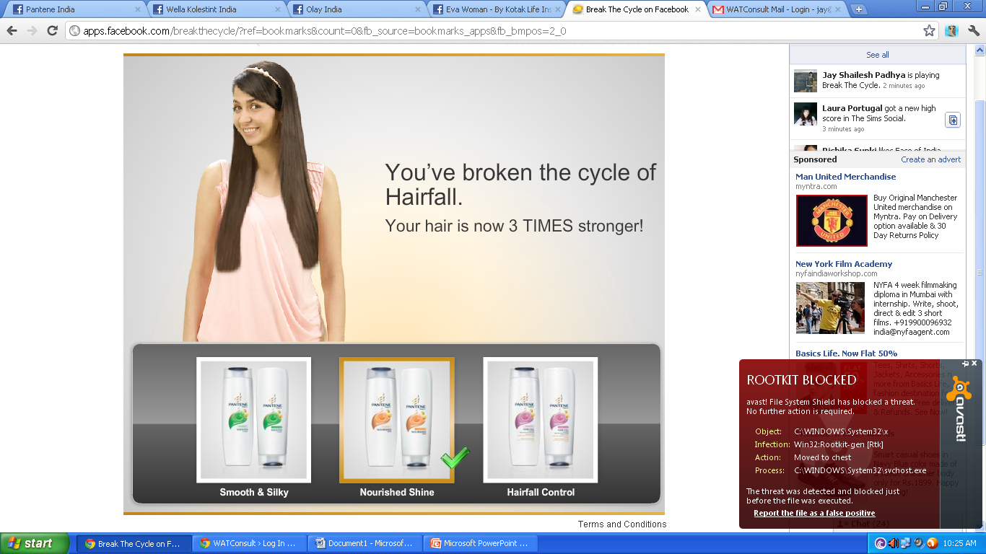
The correct Shampoo for this Level was – Nourished Shine
After Playing level 3 her hair get split ends. In order to repair her hair, she had to select the correct Shampoo!

Slide 26
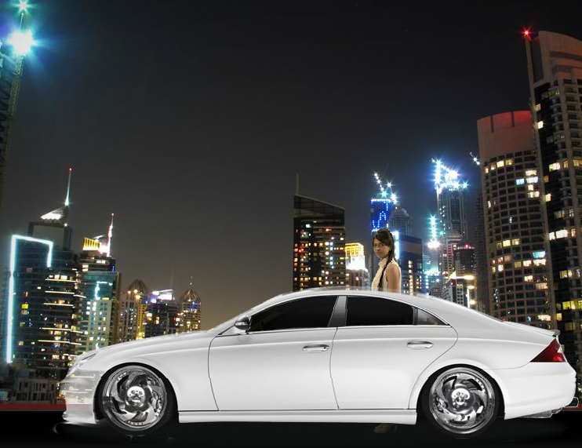
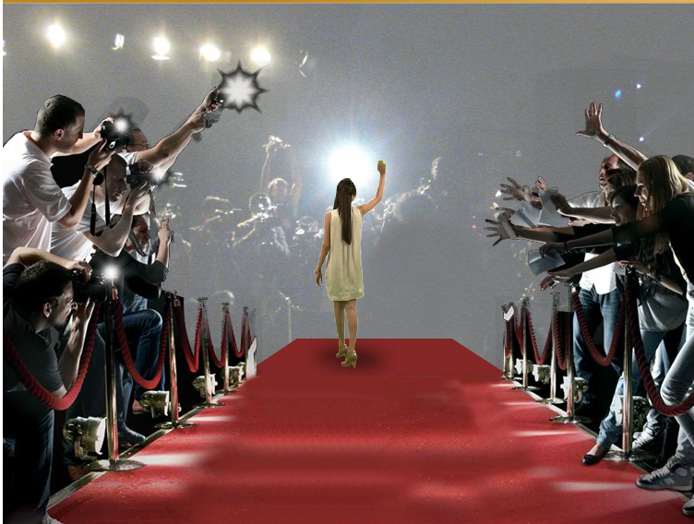
The End
The girl in the game finally breaks the cycle of her hair problems and hits the party – Red Carpet style!

Slide 27
Learnings
Strong Brand Connect via Facebook Application that becomes very viral for the brand on Facebook works
Generate traffic by creating awareness among non- users through newsfeeds and updates by existing users
Branded Facebook applications act as means of engaging customers to the fullest while increasing brand awareness and loyalty

Slide 28
Thank You

